Slide 1
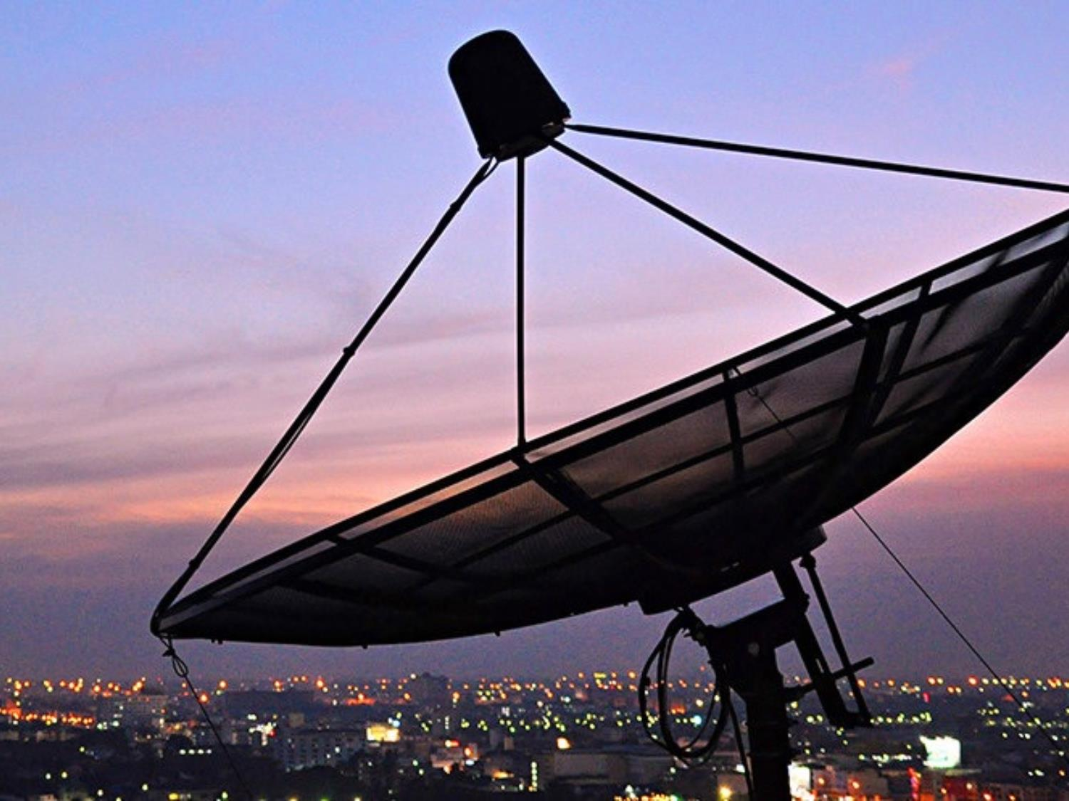
Bandwidth Utilization:
Multiplexing
Chapter 6

Slide 2

Note
Bandwidth utilization is the wise use of
available bandwidth to achieve
specific goals.
Efficiency can be achieved by multiplexing; i.e., sharing of the bandwidth between multiple users.
6.<number>

Slide 3
MULTIPLEXING
Whenever the bandwidth of a medium linking two devices is greater than the bandwidth needs of the devices, the link can be shared. Multiplexing is the set of techniques that allows the (simultaneous) transmission of multiple signals across a single data link. As data and telecommunications use increases, so does traffic.
Topics discussed in this section:
Frequency-Division Multiplexing
Wavelength-Division Multiplexing
Synchronous Time-Division Multiplexing
Statistical Time-Division Multiplexing
6.<number>

Slide 4
WHY MULTIPLEXING?
First one is it has been found that most of the individual data communication devices typically require modest data rate. (e.g., voice comm requires 4kHz BW)
On the other hand, the communication media usually have much higher bandwidth.
Two communicating stations do not utilize the full capacity of a data link.
Higher the data rate the most cost effective is the transmission facility.
6.<number>

Slide 5
WHEN MULTIPLEXING?
When the bandwidth of a medium is greater than individual signals to be transmitted through the channel a medium can be shared by more than one channel of a signals by multiplexing
For efficiency channel capacity can be shared among communicating stations.
Most common use of multiplexing in long-haul communication using co-axial cable, micro wave or optical fiber.
6.<number>

Slide 6
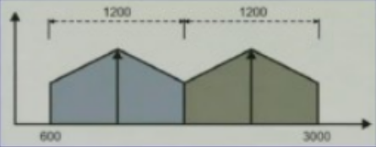
Example
Station A is communicating with station B (analog telephone). FDM can be used for full duplex communication.
6.<number>

Slide 7
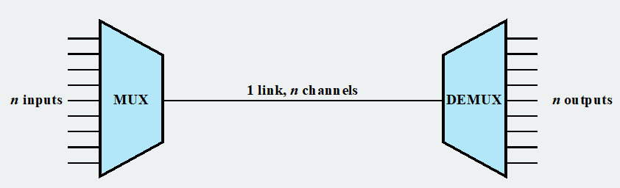
Basic Concept
A device known as multiplexer is combining the signals coming from n channels
The multiplexer is sending the combined or composite signal through a single medium.
At the other end we have an opposite device known as separates out the signals of different channels by using filtering and here we get back the signal
6.<number>

Slide 8
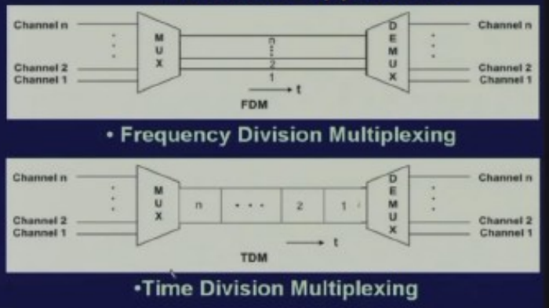
Basic Approaches
6.<number>

Slide 9
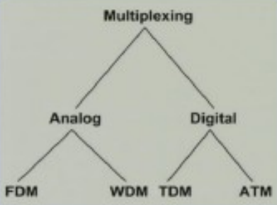
Figure 6.2 Categories of multiplexing
6.<number>

Slide 10

Figure 6.3 Frequency-division multiplexing (FDM)
6.<number>

Slide 11
Note
FDM is an analog multiplexing technique that combines analog signals.
It uses the concept of modulation.
6.<number>

Slide 12
FDM implementation
the available bandwidth of a single physical medium is divided into a number of smaller independent frequency channels.
Then using modulation independent message signals are translated into different frequency bands.
All the modulated signals are combined into a linear by using a linear summing circuit to form a composite signal for transmission
through a media.
Obviously you will require a number of carriers to modulate the individual message signals which are known as sub-carriers
6.<number>

Slide 13

Figure 6.4 FDM process
6.<number>

Slide 14

Figure 6.5 FDM demultiplexing example
6.<number>

Slide 15
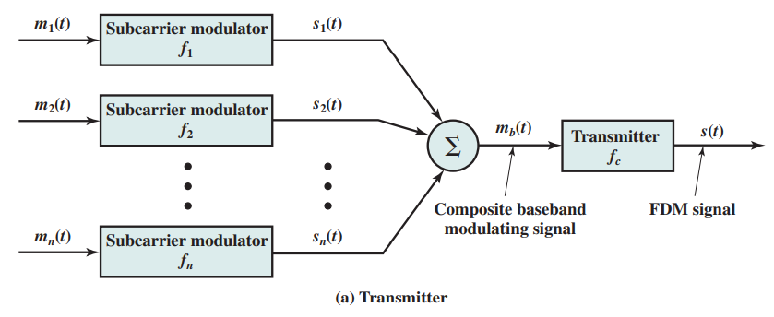
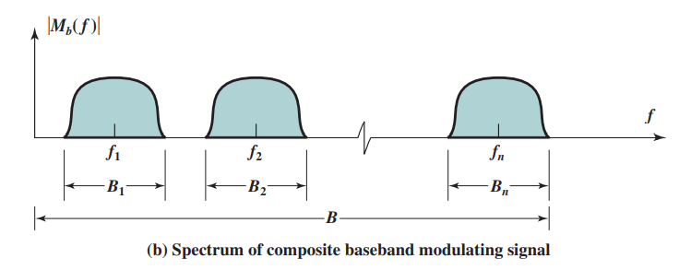
Figure 6.4 FDM process
6.<number>

Slide 16
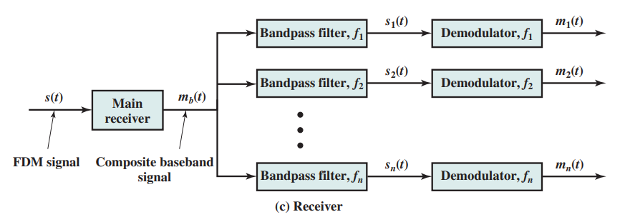
Figure 6.4 FDM process
6.<number>

Slide 17
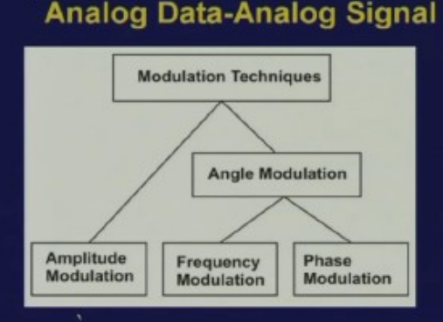
Modulation
Sometimes we shall make use amplitude modulation, sometimes we shall make use of angle modulation which has got two types namely frequency modulation and phase modulation.
6.<number>

Slide 18

Application of FDM
Transmission of AM and FM radio signals
TV broadcasting
CATV
FM
6.<number>

Slide 19
Example 6.1
Assume that a voice channel occupies a bandwidth of 4 kHz. We need to combine three voice channels into a link with a bandwidth of 12 kHz, from 20 to 32 kHz. Show the configuration, using the frequency domain. Assume there are no guard bands.
Solution
We shift (modulate) each of the three voice channels to a different bandwidth, as shown in Figure 6.6. We use the 20- to 24-kHz bandwidth for the first channel, the 24- to 28-kHz bandwidth for the second channel, and the 28- to 32-kHz bandwidth for the third one. Then we combine them as shown in Figure 6.6.
6.<number>

Slide 20

Figure 6.6 Example 6.1
6.<number>

Slide 21
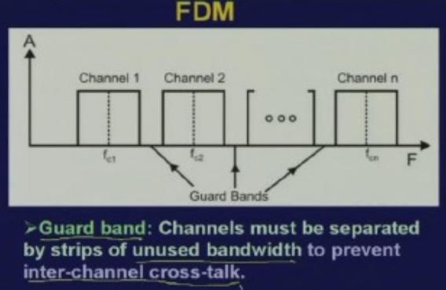
Guard Bands
6.<number>

Slide 22
Example 6.2
Five channels, each with a 100-kHz bandwidth, are to be multiplexed together. What is the minimum bandwidth of the link if there is a need for a guard band of 10 kHz between the channels to prevent interference?
Solution
For five channels, we need at least four guard bands. This means that the required bandwidth is at least
5 × 100 + 4 × 10 = 540 kHz,
as shown in Figure 6.7.
6.<number>

Slide 23

Figure 6.7 Example 6.2
6.<number>

Slide 24
Example 6.3- Not Discussed
Four data channels (digital), each transmitting at 1 Mbps, use a satellite channel of 1 MHz. Design an appropriate configuration, using FDM.
Solution
The satellite channel is analog. We divide it into four channels, each channel having 1M/4=250-kHz bandwidth.
Each digital channel of 1 Mbps must be transmitted over a 250KHz channel. Assuming no noise we can use Nyquist to get:
C = 1Mbps = 2x250K x log₂ L -> L = 4 or n = 2 bits/signal element.
One solution is 4-QAM modulation. In Figure 6.8 we show a possible configuration with L = 16.
6.<number>

Slide 25

Figure 6.8 Example 6.3
6.<number>

Slide 26
Analog Carrier Systems
The long-distance carrier system provided in the United States and throughout the world is designed to transmit voiceband signals over high-capacity transmission links, such as coaxial cable and microwave systems.
Original signal can be modulated many times
Notes:
The long-distance carrier system provided in the United States and throughout the world is designed to transmit voiceband signals over high-capacity transmission links, such as coaxial cable and microwave systems. The earliest, and still a very common, technique for utilizing high-capacity links is FDM. In the United States, AT&T has designated a hierarchy of FDM schemes to accommodate transmission systems of various capacities. A similar, but unfortunately not identical, system has been adopted internationally under the auspices of ITU-T.

Slide 27
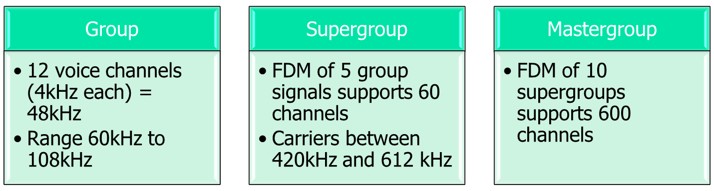
Analog Carrier Systems
Long-distance links use an FDM hierarchy
AT&T (USA) and ITU-T (International) variants
Original signal can be modulated many times
Notes:
The long-distance carrier system provided in the United States and throughout the world is designed to transmit voiceband signals over high-capacity transmission links, such as coaxial cable and microwave systems. The earliest, and still a very common, technique for utilizing high-capacity links is FDM. In the United States, AT&T has designated a hierarchy of FDM schemes to accommodate transmission systems of various capacities. A similar, but unfortunately not identical, system has been adopted internationally under the auspices of ITU-T.

Slide 28
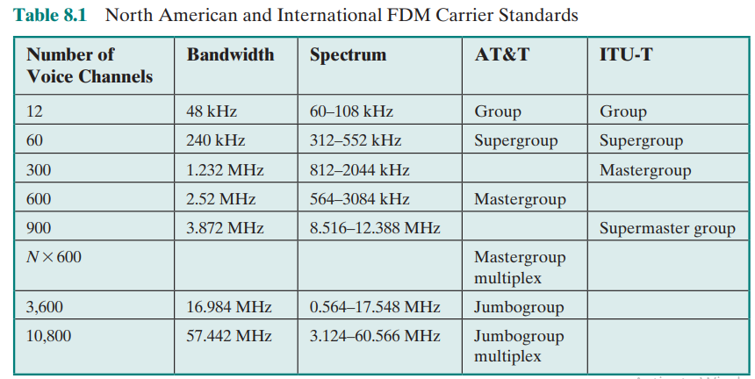
Table 8.1 Not Discussed
North American and International
FDM Carrier Standards
Notes:
At the first level of the AT&T hierarchy, 12 voice channels are combined to produce a group signal with a bandwidth of 12 × 4 kHz = 48 kHz, in the range 60 to 108 kHz. The next basic building block is the 60-channel supergroup, which is formed by frequency division multiplexing five group signals. The subcarriers have frequencies from 420 to 612 kHz in increments of 48 kHz. The resulting signal occupies 312 to 552 kHz. The next level of the hierarchy is the mastergroup, which combines 10 supergroup inputs. The mastergroup has a bandwidth of 2.52 MHz and can support 600 voice frequency (VF) channels. Higher-level multiplexing is defined above the mastergroup, as shown in Table 8.1.
Note that the original voice or data signal may be modulated many times. Each stage can distort the original data; this is so, for example, if the modulator/multiplexer contains nonlinearities or introduces noise.

Slide 29

Figure 6.9 Analog hierarchy
6.<number>

Slide 30
Example 6.4
The Advanced Mobile Phone System (AMPS) uses two bands. The first band of 824 to 849 MHz is used for sending, and 869 to 894 MHz is used for receiving. Each user has a bandwidth of 30 kHz in each direction. How many people can use their cellular phones simultaneously?
Solution
Each band is 25 MHz. If we divide 25 MHz by 30 kHz, we get 833.33. In reality, the band is divided into 832 channels. Of these, 42 channels are used for control, which means only 790 channels are available for cellular phone users.
6.<number>

Slide 31
Wavelength Division Multiplexing (WDM)
The true potential of optical fiber is fully exploited when multiple beams of light at different frequencies are transmitted on the same fiber. This is a form of frequency division multiplexing but is commonly called wavelength division multiplexing (WDM).
Notes:
The true potential of optical fiber is fully exploited when multiple beams of light at different frequencies are transmitted on the same fiber. This is a form of frequency division multiplexing (FDM) but is commonly called wavelength division multiplexing (WDM). With WDM, the light streaming through the fiber consists of many colors, or wavelengths, each carrying a separate channel of data. Commercial systems with 160 channels of 10 Gbps are now available. In a lab environment, Alcatel has carried 256 channels at 39.8 Gbps each, a total of 10.1 Tbps, over a 100-km span.
The term dense wavelength division multiplexing (DWDM) is often seen in the literature. There is no official or standard definition of this term. The term connotes the use of more channels, more closely spaced, than ordinary WDM. In general, a channel spacing of 200 GHz or less could be considered dense.

Slide 32
Wavelength Division Multiplexing (WDM)
One special type of Frequency Division Multiplexing called Wavelength Division Multiplexing that is whenever we are sending light signals through optical fiber.
(The reason is the frequency is very high so wavelength is small.)
To make use of the enormous bandwidth WDM is the most viable technology that overcomes the huge opto-electronic bandwidth mismatch
WDM optical fiber network comprises optical wavelength
switches or routers interconnected by point-to-point fiber links
Notes:
The true potential of optical fiber is fully exploited when multiple beams of light at different frequencies are transmitted on the same fiber. This is a form of frequency division multiplexing (FDM) but is commonly called wavelength division multiplexing (WDM). With WDM, the light streaming through the fiber consists of many colors, or wavelengths, each carrying a separate channel of data. Commercial systems with 160 channels of 10 Gbps are now available. In a lab environment, Alcatel has carried 256 channels at 39.8 Gbps each, a total of 10.1 Tbps, over a 100-km span.
The term dense wavelength division multiplexing (DWDM) is often seen in the literature. There is no official or standard definition of this term. The term connotes the use of more channels, more closely spaced, than ordinary WDM. In general, a channel spacing of 200 GHz or less could be considered dense.

Slide 33
Wavelength Division Multiplexing (WDM)
The end users may communicate with each other through either all-optical multiplexing channels which are known as light paths which may span over more than one fiber link. That means over a very long distance the signal can be sent in the form of light and at the other end with the help of suitable transducer. We can use the pin diodes for conversion from light signal to electrical signal and then get back the original data.
Notes:
The true potential of optical fiber is fully exploited when multiple beams of light at different frequencies are transmitted on the same fiber. This is a form of frequency division multiplexing (FDM) but is commonly called wavelength division multiplexing (WDM). With WDM, the light streaming through the fiber consists of many colors, or wavelengths, each carrying a separate channel of data. Commercial systems with 160 channels of 10 Gbps are now available. In a lab environment, Alcatel has carried 256 channels at 39.8 Gbps each, a total of 10.1 Tbps, over a 100-km span.
The term dense wavelength division multiplexing (DWDM) is often seen in the literature. There is no official or standard definition of this term. The term connotes the use of more channels, more closely spaced, than ordinary WDM. In general, a channel spacing of 200 GHz or less could be considered dense.

Slide 34
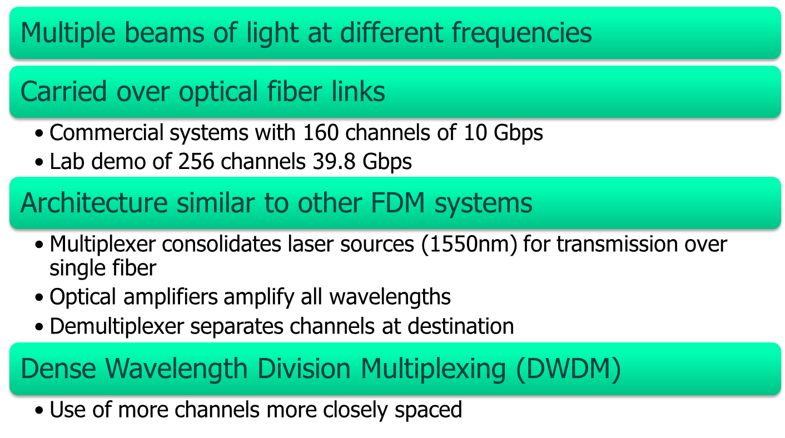
Wavelength Division Multiplexing (WDM)
Notes:
The true potential of optical fiber is fully exploited when multiple beams of light at different frequencies are transmitted on the same fiber. This is a form of frequency division multiplexing (FDM) but is commonly called wavelength division multiplexing (WDM). With WDM, the light streaming through the fiber consists of many colors, or wavelengths, each carrying a separate channel of data. Commercial systems with 160 channels of 10 Gbps are now available. In a lab environment, Alcatel has carried 256 channels at 39.8 Gbps each, a total of 10.1 Tbps, over a 100-km span.
The term dense wavelength division multiplexing (DWDM) is often seen in the literature. There is no official or standard definition of this term. The term connotes the use of more channels, more closely spaced, than ordinary WDM. In general, a channel spacing of 200 GHz or less could be considered dense.

Slide 35

Figure 6.10 Wavelength-division multiplexing (WDM)
6.<number>

Slide 36
Note
WDM is an analog multiplexing technique to combine optical signals.
6.<number>

Slide 37

Figure 6.11 Prisms in wavelength-division multiplexing and demultiplexing
How WDM can be done this multiplexing and demultiplexing
6.<number>

Slide 38
TDM
Synchronous time-division multiplexing is possible when the achievable data rate (sometimes, unfortunately, called bandwidth) of the medium exceeds the data rate of digital signals to be transmitted.
Multiple digital signals (or analog signals carrying digital data) can be carried on a single transmission path by interleaving portions of each signal in time. The interleaving can be at the bit level or in blocks of bytes or larger quantities.
Time Division Multiplexing is used when we are using digital signals and digital signals are generated by using suitable encoding technique.

Slide 39
TDM- Modulation
If the data is digital then the digital signals are generated by using three different types of coding such as unipolar, polar or bipolar.
Similarly if the original data is in analog form then digital signal can be generated by pulse code modulation or delta modulation
In either case ultimately we have got digital signals
These digital signals are expressed in terms of bits per second or Kbps that is the data rate .and these digital signals can be sent through a medium by using Time Division Multiplexing.

Slide 40
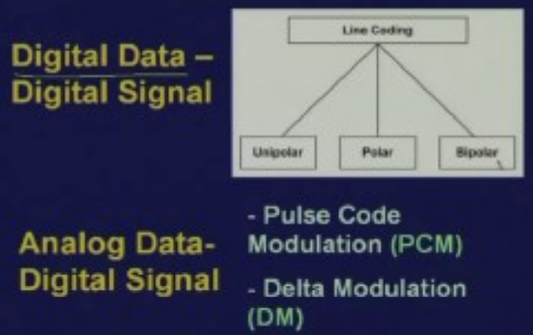
Modulation
6.<number>

Slide 41
How TDM works?
The incoming data from each source are briefly buffered and each buffer is typically one bit or one character in length depending on the interleaving level.
The buffers are scanned sequentially to form a composite data stream.
The scan operation is sufficiently rapid so that each buffer is emptied before more data can arrive.
6.<number>

Slide 42

Synchronous TDM system
Composite data rate must be at least equal to the some of individual data rates.
The composite signal can be directly transmitted or through modem.

Slide 43
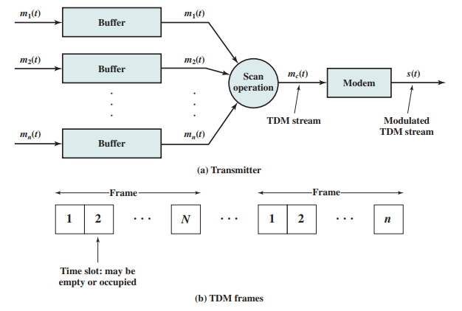
Synchronous TDM system
The signals carry digital data and are generally digital signals.

Slide 44
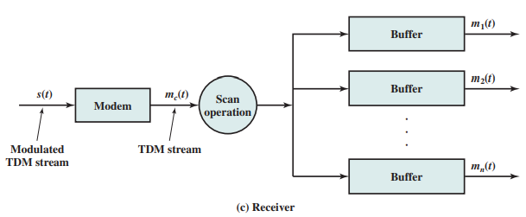
Synchronous TDM system
6.<number>

Slide 45
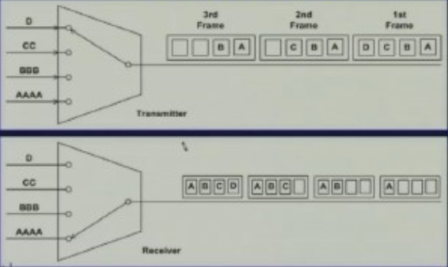
Synchronous TDM system
6.<number>

Slide 46
Note
TDM is a digital multiplexing technique for combining several low-rate digital
channels into one high-rate one.
6.<number>

Slide 47

Figure 6.13 Synchronous time-division multiplexing
6.<number>

Slide 48
Note
In synchronous TDM, the data rate
of the link is n times faster, and the unit duration is n times shorter.
6.<number>

Slide 49
Example 6.5
In Figure 6.13, the data rate for each one of the 3 input connection is 1 kbps. If 1 bit at a time is multiplexed (a unit is 1 bit), what is the duration of (a) each input slot,(means for 1 bit) (b) each output slot, and (c) each frame?
Solution
We can answer the questions as follows:
a. The data rate of each input connection is 1 kbps. This means that the bit duration is 1/1000 s or 1 ms. The duration of the input time slot is 1 ms (same as bit duration).
6.<number>

Slide 50
Example 6.5 (continued)
b. The duration of each output time slot is one-third of the input time slot. This means that the duration of the output time slot is 1/3 ms.
c. Each frame carries three output time slots. So the duration of a frame is 3 × 1/3 ms, or 1 ms.
Note: The duration of a frame is the same as the duration of an input unit.
6.<number>

Slide 51
Example 6.6
Figure 6.14 shows synchronous TDM with 4, 1Mbps data stream inputs and one data stream for the output. The unit of data is 1 bit. Find (a) the input bit duration, (b) the output bit duration, (c) the output bit rate, and (d) the output frame rate.(opposite of frame duration)
Solution
We can answer the questions as follows:
a. The input bit duration is the inverse of the bit rate:
1/1 Mbps = 1 μs.
b. The output bit duration is one-fourth of the input bit duration, or ¼ μs.
6.<number>

Slide 52
Example 6.6 (continued)
c. The output bit rate is the inverse of the output bit duration or 1/(4μs) or 4 Mbps. This can also be deduced from the fact that the output rate is 4 times as fast as any input rate; so the output rate = 4 × 1 Mbps = 4 Mbps.
d. The frame rate is always the same as any input rate. So the frame rate is 1,000,000 frames per second. Because we are sending 4 bits in each frame, we can verify the result of the previous question by multiplying the frame rate by the number of bits per frame.
6.<number>

Slide 53

Figure 6.14 Example 6.6
6.<number>

Slide 54
Example 6.7
Four 1-kbps connections are multiplexed together. A unit is 1 bit. Find (a) the duration of 1 bit before multiplexing, (b) the transmission rate of the link, (c) the duration of a time slot, and (d) the duration of a frame.
Solution
We can answer the questions as follows:
a. The duration of 1 bit before multiplexing is 1 / 1 kbps, or 0.001 s (1 ms).
b. The rate of the link is 4 times the rate of a connection, or 4 kbps.
6.<number>

Slide 55
Example 6.7 (continued)
c. The duration of each time slot is one-fourth of the duration of each bit before multiplexing, or 1/4 ms or 250 μs. Note that we can also calculate this from the data rate of the link, 4 kbps. The bit duration is the inverse of the data rate, or 1/4 kbps or 250 μs.
d. The duration of a frame is always the same as the duration of a unit before multiplexing, or 1 ms. We can also calculate this in another way. Each frame in this case has four time slots. So the duration of a frame is 4 times 250 μs, or 1 ms.
6.<number>

Slide 56
Interleaving
The process of taking a group of bits from each input line for multiplexing is called interleaving.
We interleave bits (1 - n) from each input onto one output.
6.<number>

Slide 57

Figure 6.15 Interleaving
6.<number>

Slide 58
Example 6.8
Four channels are multiplexed using TDM. If each channel sends 100 bytes /s and we multiplex 1 byte per channel, show the frame traveling on the link, the size of the frame, the duration of a frame, the frame rate, and the bit rate for the link.
Solution
The multiplexer is shown in Figure 6.16. Each frame carries 1 byte from each channel; the size of each frame, therefore, is 4 bytes, or 32 bits. Because each channel is sending 100 bytes/s and a frame carries 1 byte from each channel, the frame rate must be 100 frames per second. The bit rate is 100 × 32, or 3200 bps.
6.<number>

Slide 59

Figure 6.16 Example 6.8
6.<number>

Slide 60
Data rate matching
Multilevel: used when the data rate of the input links are multiples of each other.
Multislot: used when there is a GCD between the data rates. The higher bit rate channels are allocated more slots per frame, and the output frame rate is a multiple of each input link.
Pulse Stuffing: used when there is no GCD between the links. The slowest speed link will be brought up to the speed of the other links by bit insertion, this is called pulse stuffing.
6.<number>

Slide 61
Example 6.9
A multiplexer combines four 100-kbps channels using a time slot of 2 bits. Show the output with four arbitrary inputs. What is the frame rate? What is the frame duration? What is the bit rate? What is the bit duration?
Solution
Figure 6.17 shows the output (4x100kbps) for four arbitrary inputs. The link carries 400K/(2x4)=50,000 2x4=8bit frames per second. The frame duration is therefore 1/50,000 s or 20 μs. The bit duration on the output link is 1/400,000 s, or 2.5 μs.
6.<number>

Slide 62

Figure 6.17 Example 6.9
6.<number>

Slide 63
Data Rate control/Management
Not all input links maybe have the same data rate. Sometimes the data rate from a particular source does not match or is not multiplied at the rate at which the scanning is done while doing multiplexing.
Some links maybe slower. There maybe several different input link speeds
There are three strategies that can be used to overcome the data rate mismatch: multilevel, multislot and pulse stuffing
6.<number>

Slide 64
Data Rate Control/ Data Rate Management
Sometimes the data rate from a particular source does not match or is not multiplied at the rate at which the scanning is done while doing multiplexing.
In such a case some additional bits are added which is known as pulse stuffing or bit padding both the terminologies are used to facilitate synchronization of different data rates.
For example, if we are sampling at the rate of say 8 Kbps so here the data is coming at the rate of 8 Kbps but here it is coming at the rate of 7.2 kbps then obviously these two cannot be synchronized.
So what is done is additional bits are stuffed into this so that the data rate for this is 8 Kbps and then at the receiving end those dummy bits are taken out or separated
This is known as pulse stuffing or bit padding where signals from different data sources having different data rates can be combined by using Time Division Multiplexing.
6.<number>

Slide 65
Data Rate control/Management
There are three strategies that can be used to overcome the data rate mismatch: multilevel, multislot and pulse stuffing
6.<number>

Slide 66

Figure 6.19 Multilevel multiplexing
6.<number>

Slide 67

Figure 6.20 Multiple-slot multiplexing
6.<number>

Slide 68

Figure 6.21 Pulse stuffing
6.<number>

Slide 69
TDM- Synchonization
However, whenever we are doing the framing some additional bits are necessary for synchronization.
Usually per frame one bit is used for the purpose of synchronization.
So a special bit or a bit pattern is added in a control channel so this is used for synchronization.
For example if this is the frame at the beginning of each frame 1 is added then if it is the next frame then at the beginning of the next frame 0 is added so in this way alternately ones and zeroes are added for the purpose of synchronization.
Essentially these synchronization bits state that this is the beginning of the frame and data from different slots are coming from different sources and they are demultiplexed at the receiving end.
6.<number>

Slide 70
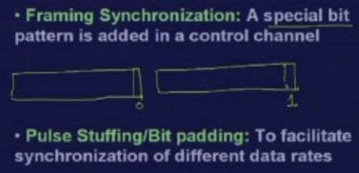
Synchonization and Pulse Stuffing
6.<number>

Slide 71
Synchronization-more
To ensure that the receiver correctly reads the incoming bits, i.e., knows the incoming bit boundaries to interpret a “1” and a “0”, a known bit pattern is used between the frames.
The receiver looks for the anticipated bit and starts counting bits till the end of the frame.
Then it starts over again with the reception of another known bit.
These bits (or bit patterns) are called synchronization bit(s).
They are part of the overhead of transmission.
6.<number>

Slide 72

Figure 6.22 Framing bits
6.<number>

Slide 73
Example 6.10
We have four sources, each creating 250 8-bit characters per second. If the interleaved unit is a character and 1 synchronizing bit is added to each frame, find (a) the data rate of each source, (b) the duration of each character in each source, (c) the frame rate, (d) the duration of each frame, (e) the number of bits in each frame, and (f) the data rate of the link.
Solution
We can answer the questions as follows:
a. The data rate of each source is 250 × 8 = 2000 bps = 2 kbps.
6.<number>

Slide 74
Example 6.10 (continued)
b. Each source sends 250 characters per second; therefore, the duration of a character is 1/250 s, or
4 ms.
c. Each frame has one character from each source, which means the link needs to send 250 frames per second to keep the transmission rate of each source.
d. The duration of each frame is 1/250 s, or 4 ms. Note that the duration of each frame is the same as the duration of each character coming from each source.
e. Each frame carries 4 characters and 1 extra synchronizing bit. This means that each frame is
4 × 8 + 1 = 33 bits.
6.<number>

Slide 75
Example 6.11
Two channels, one with a bit rate of 100 kbps and another with a bit rate of 200 kbps, are to be multiplexed. How this can be achieved? What is the frame rate? What is the frame duration? What is the bit rate of the link?
Solution
We can allocate one slot to the first channel and two slots to the second channel. Each frame carries 3 bits. The frame rate is 100,000 frames per second because it carries 1 bit from the first channel. The bit rate is 100,000 frames/s × 3 bits per frame, or 300 kbps.
6.<number>

Slide 76
Digital Carrier System
The long-distance carrier system provided in the United States and throughout the world was designed to transmit voice signals over high-capacity transmission
links, such as optical fiber, coaxial cable, and microwave.
Part of the evolution of these telecommunications networks to digital technology has been the adoption of
synchronous TDM transmission
Similar, but unfortunately not identical, hierarchy has been adopted internationally under the auspices of ITU-T (Table 8.3).
6.<number>

Slide 77
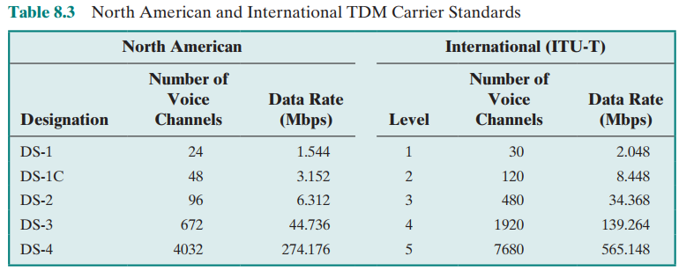
Telephone companies implement TDM through a hierarchy of digital signals, called digital signal (DS) service or digital hierarchy.
6.<number>

Slide 78
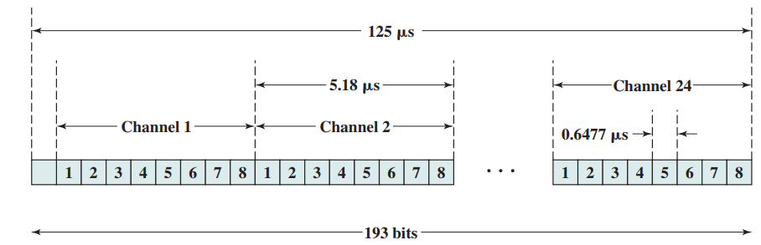
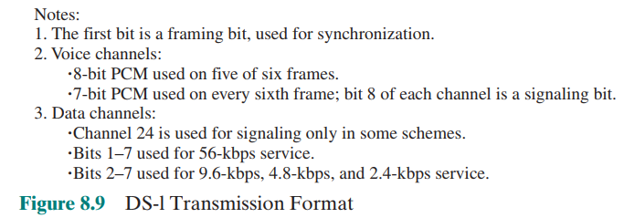
6.<number>

Slide 79

Figure 6.23 Digital hierarchy
6.<number>

Slide 80
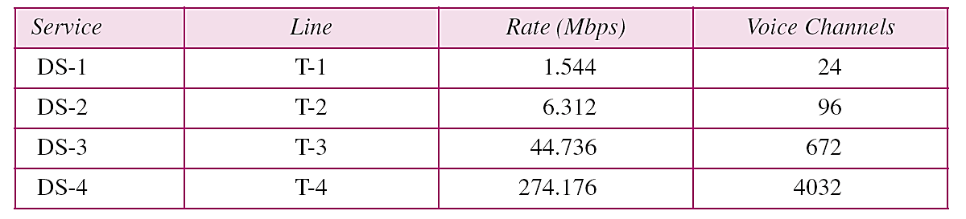
T Lines
DS-O, DS-l, and so on are the names of services. To implement those services, the telephone companies use T lines (T-l to T-4). These are lines with capacities precisely matched to the data rates of the DS-l to DS-4 services (see Table 6.1). So far only T-l and T-3 lines are commercially available.
Table 6.1 DS and T line rates
6.<number>

Slide 81
T Lines for Analog Transmission
T lines are digital lines designed for the transmission of digital data, audio, or video.
However, they also can be used for analog transmission (regular telephone connections), provided the analog signals are first sampled, then time-division multiplexed.
6.<number>

Slide 82

Figure 6.24 T-1 line for multiplexing telephone lines
6.<number>

Slide 83

Figure 6.25 T-1 frame structure
6.<number>

Slide 84
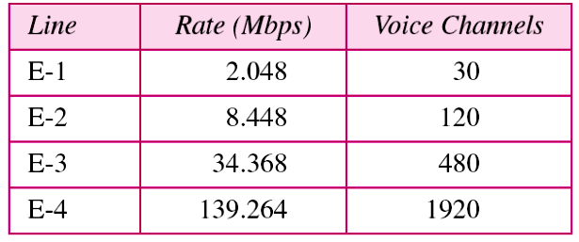
E Lines
Europeans use a version ofT lines called E lines. The two systems are conceptually identical, but their capacities differ. Table 6.2 shows the E lines and their capacities.
Table 6.2 E line rates
6.<number>

Slide 85
Inefficient use of Bandwidth
Sometimes an input link may have no data to transmit.
When that happens, one or more slots on the output link will go unused.
That is wasteful of bandwidth.
This problem is overcome by Statistical or Asynchronous or Intelligent Time Division Multiplexing.
In statistical TDM, time slots are assigned dynamically on demand.
It takes the advantage of the fact that all the stations are transmitting all the time.
6.<number>

Slide 86

Figure 6.18 Empty slots
Synchronous TDM
6.<number>

Slide 87

Figure 6.26 TDM slot comparison
6.<number>

Slide 88
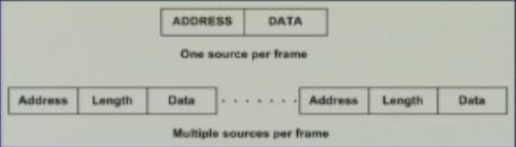
Asynchronous TDM
In Asnchronous TDM since the data arrives from different sources and are distributed to IO lines unpredictably address information is required.
And whenever there is a frame coming from multiple sources we shall also require address information and length of data if we use variable length data coming from different sources for each of the sources.
6.<number>

Slide 89
Asynchronous TDM
In Asynchronous TDM the data rate at the output is less than the data rate at the inputs.
However, in peak periods the inputs may exceed capacity. Because the output bandwidth is smaller then the sum total of the input bandwidth so in peak periods there will be some kind of overflow and it will exceed the capacity.
To overcome this we can use buffers of suitable size to store the data then they can be selected at later time slots.
Let’s assume n=number of inputs, r =data rate of each of the source, M=effective capacity of the output and α= mean fraction of time each input is transmitting (0≤α≤1), compression ratio C=M/nr bounded by α<C<1.
6.<number>

Slide 90
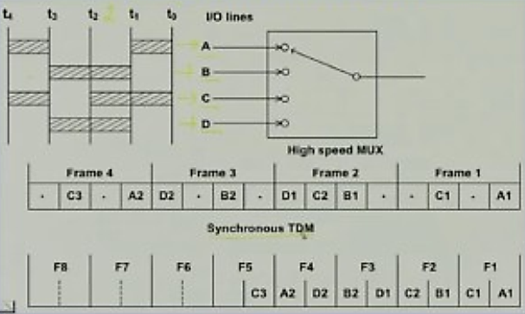
Asynchronous TDM
6.<number>

Slide 91
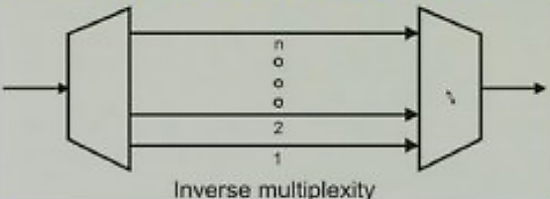
Inverse Multiplexing
Here signal of higher bandwidth then it is divided into a number of channels of smaller bandwidth and at the other end opposite operation is done.
Suppose you have to send voice which will typically require 64 Kbps then let us assume we have to send data which will require say 128 Kbps and video which will require say 1.544 Mbps.
6.<number>

